Slide 1
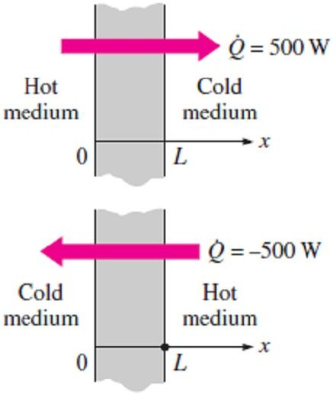
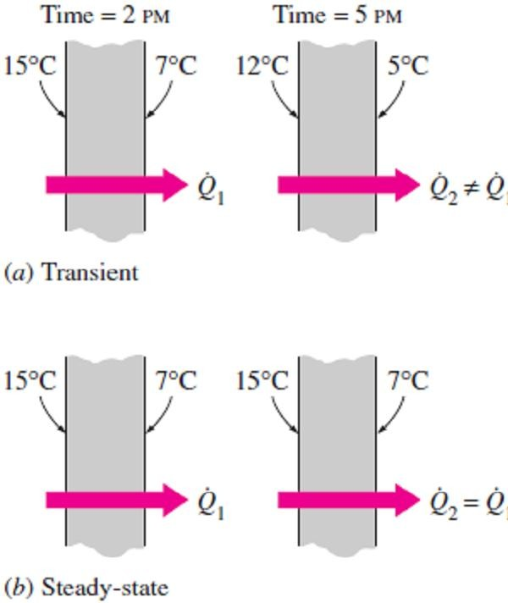
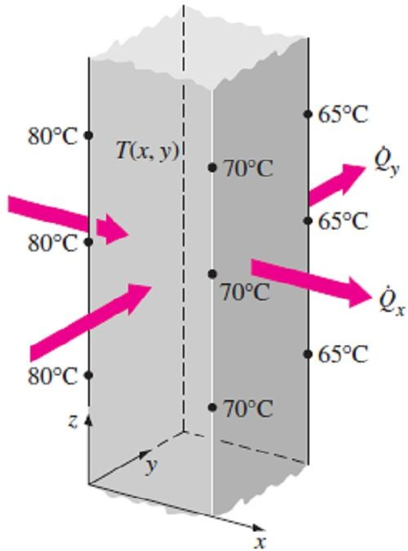
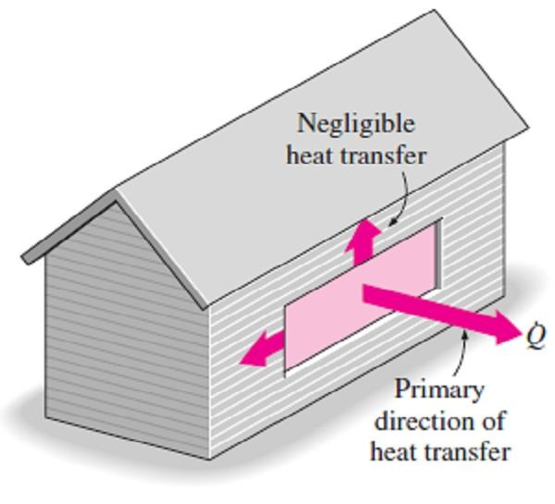
Chapter Two Heat Conduction Equation
2.1- Introduction
In the previous chapter, heat conduction was defined as the transfer of thermal energy from the more energetic particles of a medium to the adjacent less energetic ones. Although heat transfer and temperature are closely related, they are of a different nature. Unlike temperature, heat transfer has direction as well as magnitude, and thus it is a vector quantity as in Fig.(2.1). Therefore, we must specify both direction and magnitude in order to describe heat transfer completely at a point.
2.1.1- Steady and Unsteady (Transient) Heat Transfer
The term steady implies no change with time at any point within the Fig.(2.1) Indicating direction of
medium, while transient implies variation with time or time dependence.
heat transfer
Therefore, the temperature or heat flux remains unchanged with time during steady heat transfer through a medium at any location, although both quantities may vary from one location to another, as in Fig.(2.2).
2.1.2- Multidimensional Heat Transfer
Heat transfer problems are also classified as being one-dimensional, two-dimensional, or three-dimensional, depending on the relative magnitudes of heat transfer rates in different directions and the level of accuracy desired.
Note1- In the most general case, heat transfer through a medium is three-dimensional. That is, the temperature varies along all three primary directions within the medium during the heat transfer process.
Note2- A heat transfer problem in that case is said to be two-
dimensional if the temperature in a medium varies mainly in two
Fig.(2.2) Steady and transient
primary directions, while its variation in the third direction is too small heat conduction in a plane wall
or negligible, as in the steady temperature distribution in a long bar of rectangular cross section which is shown in Fig.(2.3).
Note3- A heat transfer problem is said to be one-dimensional if the temperature in the medium varies in one direction only and thus heat is
transferred in one direction, while its variation in the third direction is too small or negligible. For example, heat transfer through the glass of a
window can be considered to be one-dimensional since heat transfer through the glass will occur predominantly in one direction normal to
the surface of the glass and heat transfer in other is negligible as shown in Fig.(2.4).
2.1.3- Heat Generation
In heat conduction analysis, if there is a medium through which heat
is conducted involves a conversion of electrical, nuclear, or chemical
Fig.(2.3) Two-dimensional heat
energy into heat (or thermal) energy, such conversion processes are transfer in a long rectangular bar
characterized as heat generation.
Note1- The temperature of a resistance wire rises rapidly when electric current passes through it as a result of the electrical energy being converted to heat at a rate of I²R, where I is the current and R is the electrical resistance of the wire.
Note2- Heat generation is a volumetric phenomenon. That is, it occurs throughout the body of a medium. Therefore, the rate of heat generation
in a medium is usually specified per unit volume and is denoted by g and whose unit is W/m³ or Btu/h · ft³.
Note3- In the special case of uniform heat generation, the total rate of
Fig.(2.4) Heat transfer through a window of a house can be taken to be one-dimensional
heat generation in a medium of volume V can be determined from;
G = g V (W ) ☹(2.1)

Slide 2
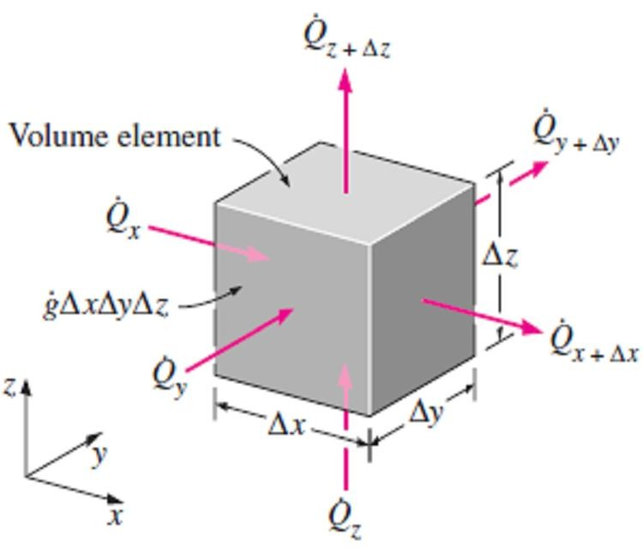
Chapter Two
Heat Conduction Equation
2.2- General Heat Conduction Equation 2.2.1- Rectangular Coordinates
Consider a small rectangular volumetric element of
length Δx, width Δy, and height Δz, as shown in Fig.(2.5). Assume the density of the body is ρ and the specific heat is
C. An energy balance on this element during a small time
interval Δt can be expressed as;
∑ ^{E}in ⁻ ∑ ^{E}out ^{+ G = ΔE} stored
☹(2.2)
where E _{in} & E _{out} represent the entered and left energy
flow respectively to and from the volumetric element, and
Fig.(2.5) Three-dimensional heat conduction through a rectangular volumetric element
their values will be as follow;
∑ E _{in} = Q _{x} + Q _{y} + Q _{z}
☹(2.3.a)
∑ ^{E}out ^{= Q} x + Δx ^{+ Q} y +Δy ^{+ Q} z + Δz
☹(2.3.b)
while G & E _{stored} represent the rate of heat generation and the rate of change of stored or accumulated energy in the volumetric element. Noting that the volume of the element is V_{element}=Δx Δy Δz, thus, the
rate of heat generation within the element and the change in the energy content of the element can be expressed as;
G = g V_{element} = g Δx Δy Δz ☹(2.3.c)
^{E}stored ^{− E} stored
_{ΔE} _{stored =} t +Δt t
Δt
= m C ^{(Tt +Δt − Tt )} =  C Δx Δy Δz ^{(Tt +Δt − Tt )}
☹(2.3.d )
Δt Δt
By substituting Eqs.[(2.3.a), (2.3.b), (2.3.c) &(2.3.d)] into Eq.(2.2) we get;
_{Q}
(T − T )
+ Q _{y} + Q _{z} − Q _{x+Δx} − Q − Q + g Δx Δy Δz =  C Δx Δy Δz ^{t+Δt t}
x
y +Δy
z+Δz
Δt
Dividing by Δx Δy Δz gives;
₋ ^{1 Q} x+Δx ^{− Q} x
Δy Δz Δx
−
1 ^{Q} y +Δy ^{− Q} y
Δx Δz Δy
−
^{1 Q} z+Δz ^{− Q} z
Δx Δy Δz
+ g =  C ^{(Tt +Δt}
T_{t} )
Δt
☹(2.4)
By noting that the heat transfer areas of the element for heat conduction in the x, y, and z directions are (A_{x}=ΔyΔz, A_{y}=ΔxΔz, and A_{z}=ΔxΔy), respectively, and taking the limit as (Δx, Δy, Δz and Δt → 0) to the terms in Eq.(2.4), where from the definition of the derivative and Fourier’s law of heat conduction yields;
1 1 ∂Q _{x =} 1
lim
^{Q} x+Δx ^{− Q} x ₌
∂ ⎛ − k Δy Δz ^{∂T ⎞} = − ∂ ⎛ k ^{∂T ⎞}
Δx→0 _{Δy Δz}
Δx ^{Q} y +Δy ^{− Q} y
Δy Δz ∂x Δy Δz ∂x ⎝
⎜ ⎟ ⎜ ⎟
∂x ⎠ ∂x ⎝ ∂x ⎠
1
1
∂Q _{y}
1 ∂ ⎛ ∂T ⎞
∂ ⎛ ∂T ⎞
^{lim} Δx Δz Δy ⁼ Δx Δz ∂y
= _{Δx Δz ∂y} ⎜ − k Δx Δz _{∂y} ⎟ = − _{∂y} ⎜ k _{∂y} ⎟
Δy→0

⎝
⎠
⎝
⎠
lim
1
^{Q} z +Δz ^{− Q} z ₌
1 ∂Q
=
1 ∂ ⎛ ∂T
⎞ ∂ ⎛ ∂T ⎞
Δz→0 _{Δx Δy}
Δz
z
⎜
k Δx Δy
⎟
= − k
⎜ ⎟
Δx Δy ∂z Δx Δy ∂z ⎝
∂z ⎠ ∂z ⎝ ∂z ⎠
_{lim} (T_{t+Δt} − T_{t} ) ₌ ∂T
Δt→0
Δt ∂t

Slide 3
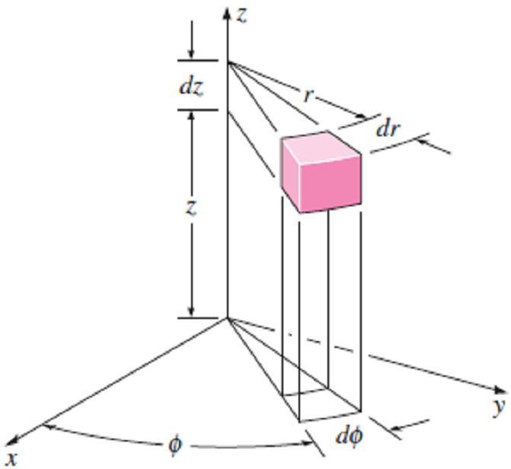
Chapter Two Heat Conduction Equation
By substituting the previous differential terms in Eq.(2.4), we get the general heat conduction equation in rectangular coordinates as follow;
∂ ⎛ ∂T ⎞ ∂ ⎛ ∂T ⎞ ∂ ⎛ ∂T ⎞ ∂T
 ☹(2.5)
∂x ^{⎜ k} ∂x ^{⎟ +} ∂y ^{⎜ k} ∂y ^{⎟ +} ∂z ^{⎜ k} ∂z ^{⎟ + g =  C} ∂t
⎝ ⎠
⎝ ⎠
⎝ ⎠
Note1- In the case of constant thermal conductivity k, Eq.(2.5) reduces to;
∂ ²T ₊ ∂ ²T ₊ ∂ ²T ₊ g ₌ 1 ∂T
☹(2.6)
∂x ² ∂y ² ∂z ² k  ∂t
Above equation is known as the Fourier-Biot equation, where the property α = k/ρC is again the
thermal diffusivity of the material.
Note2- Equation (2.6) can be reduced to the following forms under specified conditions;
(1) Steady-state:
(called the Poisson equation)
(2) Transient, no heat generation:
∂ ²T ₊ ∂ ²T ₊ ∂ ²T
+ ^{g} = 0 ☹(2.7.a)
∂x² ∂y ² ∂z ² k
(called the diffusion equation)
∂ ²T ₊ ∂ ²T ₊ ∂ ²T ₌ 1 ∂T
☹(2.7.b)
∂x ² ∂y ² ∂z ²  ∂t
(3) Steady-state, no heat generation:
∂ ²T ₊ ∂ ²T ₊ ∂ ²T ₌
(called the Laplace equation)
∂x ² ∂y ² ∂z ²
0
☹(2.7.c)
2.2.2- Cylindrical Coordinates
The general heat conduction equation in cylindrical coordinates can be obtained from an energy balance on a volume element in cylindrical coordinates, which is shown in Fig.(2.6), by following the steps just outlined in rectangular coordinates. It can also be obtained directly from Eq.(2.5) by coordinate transformation using the following relations between the coordinates of a point in rectangular and cylindrical coordinate systems;
x = r cos Ø, y = r sin Ø, and z = z ...(2.8) After lengthy manipulations, we obtain;
1 ∂ ⎛ _{k r} ∂T ⎞ ₊ 1 ∂ ⎛ _{k r} ∂T ⎞ ∂ ⎛ _{k} ∂T ⎞ _{+ g =  C} ∂T
r ∂r ⎜ ∂r ⎟ r ∂
⎜
∂ ^{⎟ +} ∂z ⎜ ∂z ⎟ ∂t
⎝
⎠
2
⎝
⎠
⎝
⎠
_{☹(2.8)} Fig.(2.6) A differential volume element
in cylindrical coordinates
2.3- One-Dimensional Heat Conduction Equation
2.3.1- Heat Conduction Equation in a Large Plane Wall (Rectangular Coordinates)
Consider a thin element of thickness Δx in a large plane wall, as shown in Fig.(2.7). Assume the density of the wall is ρ, the specific heat is C, and the area of the wall normal to the direction of heat transfer is A. Because the large dimensions of the wall in (y & z) directions, So, we can neglect the temperature variation with these directions from Eq.(2.5) to obtain the one-dimensional Fourier-Biot equation in rectangular coordinates as follow;
- Variable thermal conductivity k;
∂ ⎛ _{k} ∂T ⎞ _{+ g =  C} ∂T
☹(2.9.a)
∂x ⎜ ∂x ⎟ ∂t
⎝ ⎠
- Constant thermal conductivity k;
∂ ²T ₊ g ₌ 1 ∂T
☹(2.9.b)
∂x² k  ∂t

Slide 4
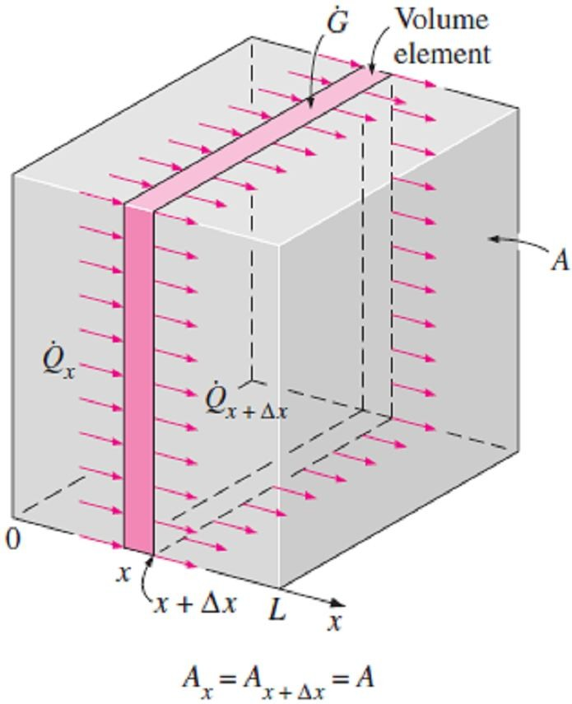
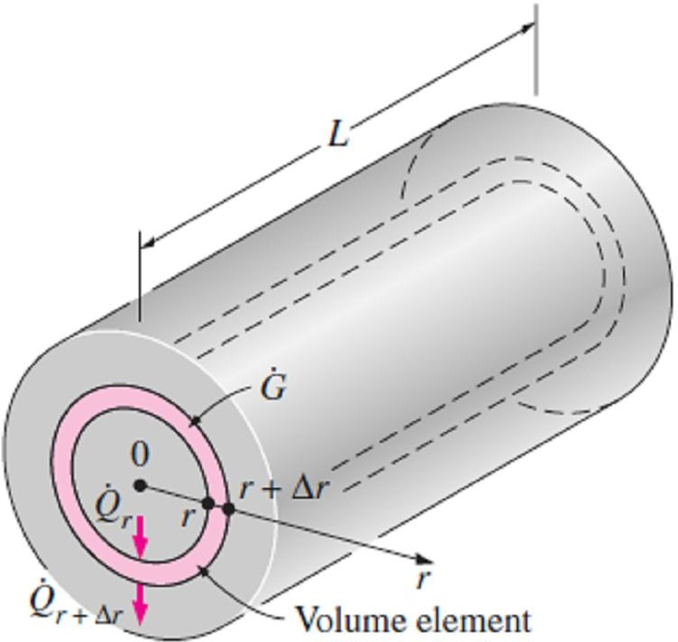
Chapter Two Heat Conduction Equation
Note- Eq.(2.9.b) can be reduced to the following forms under specified conditions;
(1) Steady-state (∂/∂t =0):
∂ ²T ₊ g ₌
0 ☹(2.10.a)
∂x² k
(2) Transient, no heat generation ( g =0):
∂ ²T 1 ∂T
∂x²
☹(2.10.b)
⁼  ∂t
(3) Steady-state, no heat generation (∂/∂t =0 & g =0):
∂ ²T
= 0 ☹(2.10.c)
∂x²
2.3.2- Heat Conduction Equation in a Long Cylinder (Cylindrical Coordinates)
Consider a thin cylindrical shell element of thickness Δr in a long cylinder, as shown in Fig.(2.8). Assume the density of the cylinder is ρ, the specific heat is C, and the length is L. The area of the cylinder normal to the direction of heat transfer at any location is A = 2πrL where r is the value of the radius at that location. Note that the heat transfer area A depends on r in this case, and thus it varies with location. So, By neglecting the temperature variation in the (Ø & z) directions from Eq.(2.8), we'll obtain the one-dimensional Fourier-Biot equation in cylindrical coordinates as follow;
- Variable thermal conductivity k;
^{1 ∂ ⎛} k r ^{∂T ⎞} + g =  C ^{∂T} ☹(2.11.a)
r ∂r ⎜ ∂r ⎟ ∂t
⎝ ⎠
- Constant thermal conductivity k;
1 ∂ ⎛ _{r} ∂T ⎞ ₊ g ₌ 1 ∂T
☹(2.11.b)
r ∂r ⎜ ∂r ⎟ k  ∂t
⎝ ⎠
Note- Eq.(2.11.b) can be reduced to the following forms under specified conditions;
(1) Steady-state (∂/∂t =0):
1 ∂ ⎛ _{r} ∂T ⎞ ₊ g ₌ ₀
☹(2.12.a)
r ∂r ⎜ ∂r ⎟ k
⎝
⎠
(2) Transient, no heat generation ( g =0):
1 ∂ ⎛ _{r} ∂T ⎞ ₌ 1 ∂T
☹(2.12.b)
r ∂r ⎜ ∂r ⎟  ∂t
⎝
⎠
(3) Steady-state, no heat generation (∂/∂t =0 & g =0):
1 ∂ ⎛ _{r} ∂T ⎞ ₌ ₀
☹(2.12.c)
r ∂r ⎜ ∂r ⎟
⎝
⎠
Fig.(2.7) One-dimensional heat conduction through a volume element in a large plane wall
Fig.(2.8) One-dimensional heat conduction through a volume element in a long cylinder

Slide 5
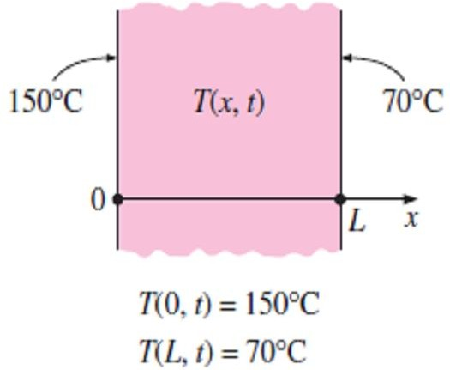
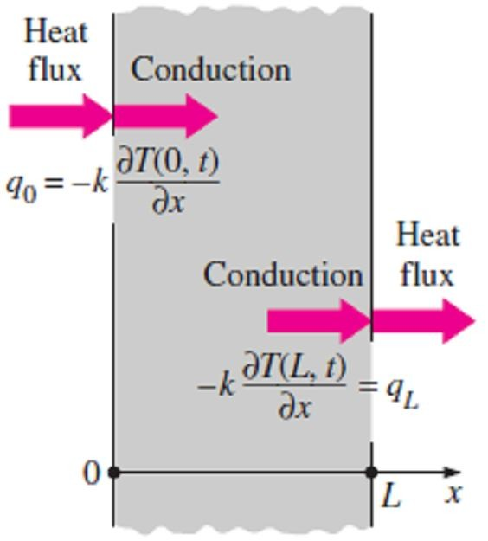
Chapter Two Heat Conduction Equation
2.3- Boundary and Initial Conditions
The heat conduction equations above were developed using an energy balance on a differential element inside the medium, and they remain unuseful without the thermal conditions on the surfaces
of the medium, where the mathematical expressions of the thermal conditions at the boundaries are
called the boundary conditions.
2.3.1- Initial Conditions
The temperature at any point on a wall at a specified time depends on the condition of that surface at the beginning of the heat conduction process. Such a condition, which is usually specified at time t = 0, is called the initial condition, which is a mathematical expression for the temperature distribution of the medium initially. In rectangular coordinates, the initial condition can be specified in the general
form as;
T ( x, y, z, 0) = f ( x, y, z) ☹(2.13)
where the function f(x, y, z) represents the temperature distribution throughout the medium at time t=0. Note1- We need only one initial condition for a heat conduction problem regardless of the dimension since the conduction equation is first order in time (it involves the first derivative of temperature with respect to time).
Note2- When the medium is initially at a uniform temperature of T_{i}, the initial condition of Eq.(2.13)
can be expressed as; T ( x, y, z, 0) = T_{i} .
Note3- Under steady conditions, the heat conduction equation does not involve any time derivatives,
and thus, we do not need to specify an initial condition.
2.3.2- Boundary Conditions
The heat conduction equation is second order in space coordinates, and thus a boundary condition may involve first derivatives at the boundaries as well as specified values of temperature. Boundary conditions most commonly encountered in practice are the specified temperature, specified heat flux, convection, and radiation boundary conditions.
2.3.2.a- Specified Temperature Boundary Condition
For one-dimensional heat transfer through a plane wall of thickness L as shown in Fig.(2.9), for example, the specified temperature boundary conditions can be expressed as;
T (0, t ) = T₁ ⎫
☹(2.14)
T (L, t) = T ⎬
2 ⎭
where T₁ and T₂ are the specified temperatures at surfaces at x=0 and x=L
respectively.
2.3.2.b- Specified Heat Flux Boundary Condition
Fig.(2.9) Specified temperature boundary conditions on both surfaces of a plane wall
The heat flux q (heat transfer rate per unit surface area, W/m²) in the
positive x-direction anywhere in the medium, including the boundaries, can be expressed by Fourier’s law of heat conduction as;
q = −k ^{dT} = ⎛
⎜
Heat flux in the ⎞
⎟ (W / m² ) ☹(2.15)
dx ⎝ positive x - direction ⎠
For a plane wall of thickness L subjected to heat fluxes q₀ and q_{L} at surfaces at x=0 and x=L respectively as shown in Fig.(2.10), for example, Then the boundary condition at a boundaries is obtained as follow;
q
_{= −k} ∂T (0, t ) ⇒ ∂T (0, t) ₌ ₋ q₀ ⎫
0
∂x
∂T (L, t )
∂x
⎪
∂x
∂T (L, t) q ⎬
∂x
k
☹(2.16)
q_{L} = −k
⇒
= −
L ⎪
k ⎭
Fig.(2.10) Specified heat flux boundary conditions on both surfaces of a plane wall

Slide 6
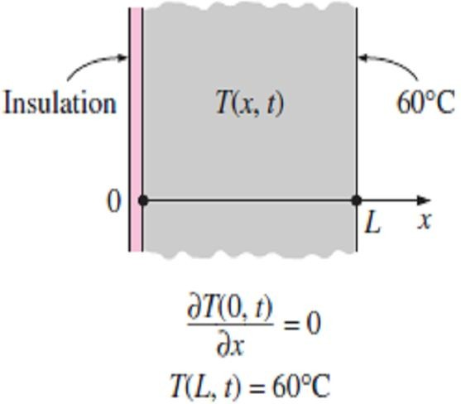
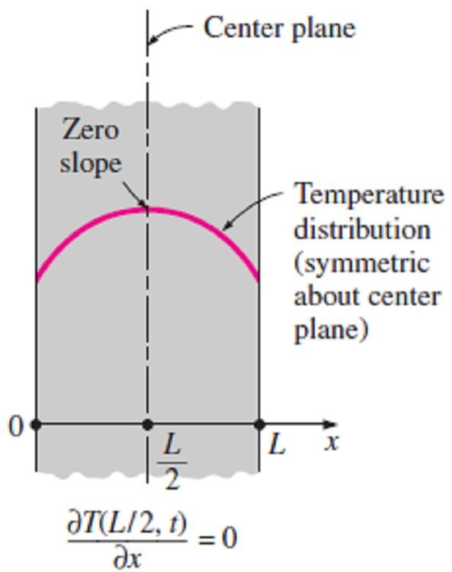
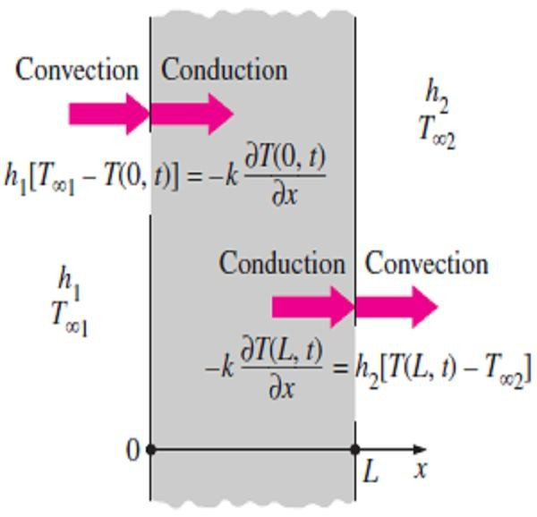
Chapter Two Heat Conduction Equation
Note1- It is very important to have the correct sign for the specified heat flux since the wrong sign will invert the direction of heat transfer and cause the heat gain to be interpreted as heat loss as shown in Fig.(2.10).
Note2- There are some special cases of specified heat flux boundary
condition as follow;
- Special Case1: Insulated Boundary Condition
Some surfaces are commonly insulated in practice in order to minimize heat loss (or heat gain) through them. Insulation reduces heat transfer but does not totally eliminate it unless its thickness is infinity. However, heat transfer through a properly insulated surface can be taken to be zero since adequate insulation reduces heat transfer through a surface to negligible levels. Therefore, a well-insulated surface can be modeled as a surface with a specified heat flux of zero. Then the boundary condition on a
perfectly insulated surface at x = 0 as shown in Fig.(2.11), for example, can be expressed as follow;
∂T (0, t) ∂T (0, t)
Fig.(2.11) A plane wall with insulation and specified temperature boundary conditions
q₀ = −k
= 0 , or; = 0 ☹(2.17)
∂x ∂x
That is, on an insulated surface, the first derivative of temperature with
respect to the space variable (the temperature gradient) in the direction
normal to the insulated surface is zero.
- Special Case2: Thermal Symmetry
Some heat transfer problems possess thermal symmetry as a result of the symmetry in imposed thermal conditions. For example, the two surfaces of a large hot plate of thickness L suspended vertically in air will be subjected to the same thermal conditions, and thus the temperature distribution in one half of the plate will be the same as that in the other half. That is, the heat transfer problem in this plate will possess thermal symmetry about the center plane at x = L/2. Therefore, the center plane can be viewed as an insulated surface as shown in Fig.(2.12), where the thermal condition at this plane of symmetry can be expressed as;
∂T (L / 2, t) ₌ ₀
☹(2.18)
Fig.(2.12) Thermal symmetry boundary condition at the center plane of plane wall
∂x
2.3.2.c- Convection Boundary Condition
The convection boundary condition is based on a surface energy balance expressed as;
⎛ Heat conduction ⎞ ⎛ Heat convection ⎞
⎜ ⎟ ⎜ ⎟
⎜ at the surfacein a ⎟ = ⎜ at the surfacein ⎟ ☹(2.16.a)
⎜ selected direction⎟ ⎜ the samedirection⎟
⎝ ⎠ ⎝ ⎠
For one-dimensional heat transfer in the x-direction in a plate of thickness L as shown in Fig.(2.13), the convection boundary conditions on both surfaces can be expressed as;
_{− k} ∂T (0, t ) _{= h [T}
− T (0, t )] ⎫
∂x
∂T ( L, t )
1 ∞1
⎪
⎬
☹(2.16.b)
k = h [T (L, t ) − T
]⎪
∂x
2
∞ 2 ⎪⎭
where h₁ and h₂ are the convection heat transfer coefficients and T_{∞1} and T_{∞2} are the temperatures of the surrounding mediums on the two sides of the plate.
Fig.(2.13) Convection boundary conditions on the two surfaces of a plane wall

Slide 7
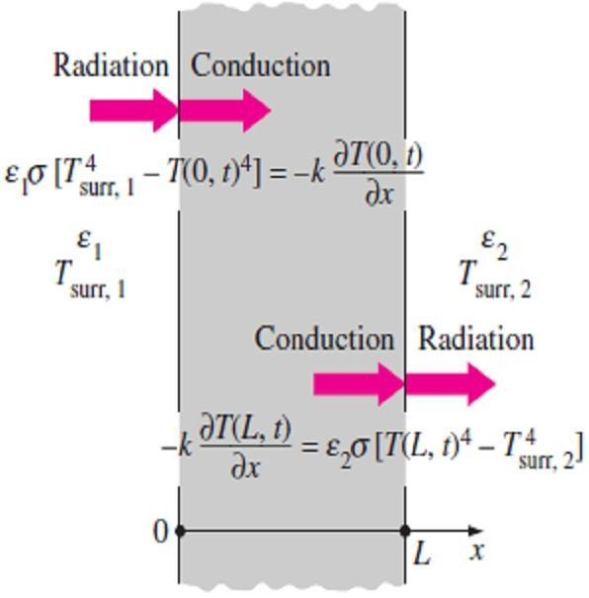
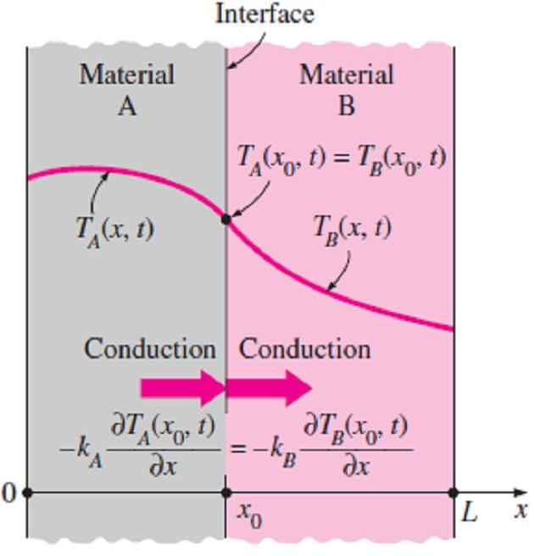
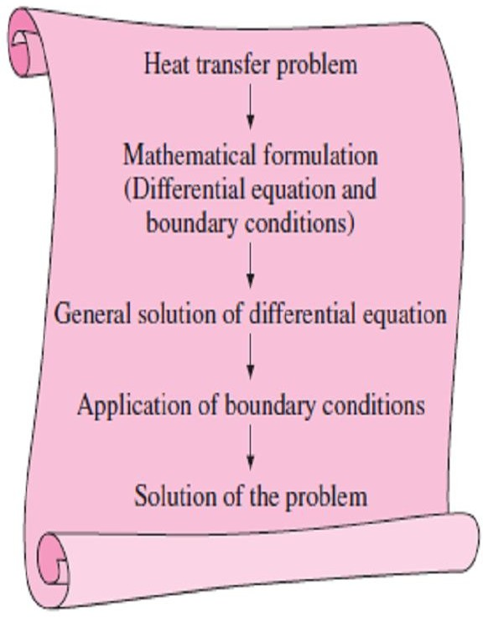
Chapter Two Heat Conduction Equation
2.3.2.d- Radiation Boundary Condition
Using an energy balance, the radiation boundary condition on a surface can be expressed as;
⎛ Heat conduction ⎞ ⎛ Radiationexchange⎞
⎜ ⎟ ⎜ ⎟
⎜ at the surfacein a ⎟ = ⎜ at the surfacein the ⎟ ☹(2.17.a)
⎜ selected direction⎟
⎜
samedirection
⎟
⎝ ⎠ ⎝ ⎠
For one-dimensional heat transfer in the x-direction in a plate of thickness L as shown in Fig.(2.14), the radiation boundary conditions on both surfaces can be expressed as;
k
∂T (0, t)
∂x
∂T ( L, t)
=   [T
4
T ⁴
] ⎫
1
surr 1 (0, t )
⎪
⎬
☹(2.17.b)
− k =   [T ⁴ − T ⁴
]⎪
∂x
2
( L, t ) surr 2 ⎪⎭
Fig.(2.14) Radiation boundary
where ε₁ and ε₂ are the emissivities of the boundary surfaces, σ = 5.6 ×10⁸ conditions on both surfaces of a
(W/m² · K° ⁴) is the Stefan–Boltzmann constant, and T_{surr1} and T_{surr2} are the temperatures of the surfaces surrounding the two sides of the plate, respectively.
2.3.2.e- Interface Boundary Conditions
The boundary conditions at the interface of two bodies A and B in
perfect contact at x = x₀, as shown in Fig.(2.15), can be expressed as;
plane wall
T_{A} ( x₀ , t) = T_{B} ( x₀ , t) ⎫
☹(2.18)
∂T (x , t) ∂T ( x ,t) ⎪
k
A 0 _{= −k} B 0 ⎬
A B
⎪⎭
∂x ∂x
where k_{A} and k_{B} are the thermal conductivities of the layers A and B, respectively.
Note- The above conditions of perfect contact are based on the following
requirements;
Two bodies in contact must have the same temperature at the area of contact.
An interface (which is a surface) cannot store any energy, and Fig.(2.15) Boundary conditions
thus, the heat flux on the two sides of an interface must be the at the interface of two bodies in
same.
2.3.2.f- Generalized Boundary Conditions
In general, a surface may involve convection, radiation, and specified heat flux simultaneously. So, the boundary condition in such cases is again obtained from a surface energy balance, expressed as;
perfect contact
⎛ Heat transfer⎞ ⎛ Heat transfer ⎞
⎜ ⎟ ⎜
⎟
⎜ to the surface ⎟ = ⎜ from the surface⎟
☹(2.19)
⎜ in all modes ⎟
⎜
in all mode
⎟
⎝ ⎠ ⎝ ⎠
2.4- Solution of Steady One-Dimensional Heat Conduction Problems
The solution procedure for solving heat conduction problems, as shown in Fig.(2.17), can be summarized as;
(1) formulate the problem by obtaining the applicable differential
equation in its simplest form and specifying the boundary conditions.
(2) obtain the general solution of the differential equation.
(3) apply the boundary conditions and determine the arbitrary constants
Fig.(2.17) Basic steps involved in the solution of heat transfer problems
in the general solution.

Slide 8
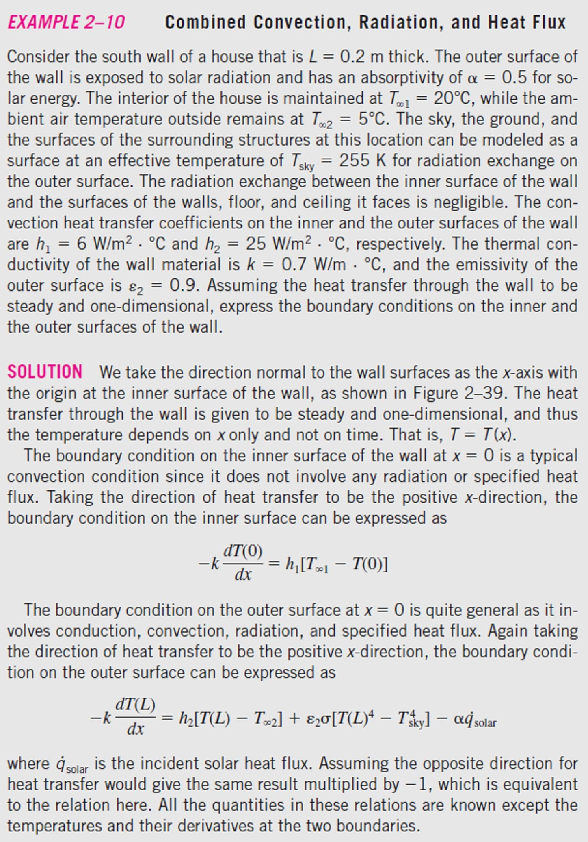
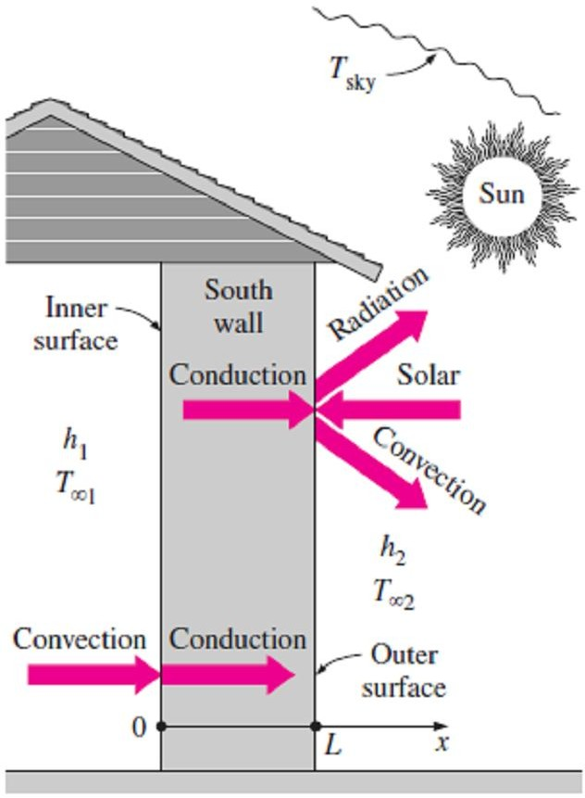
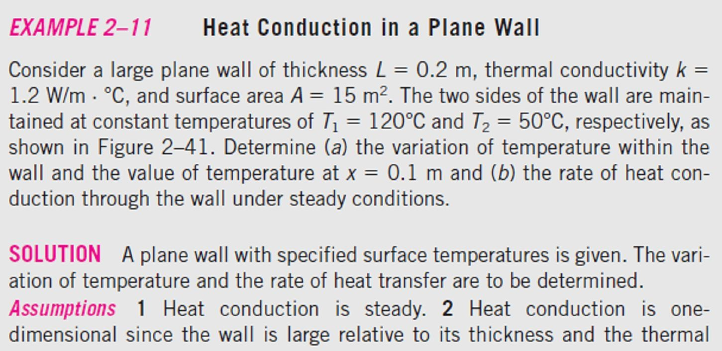
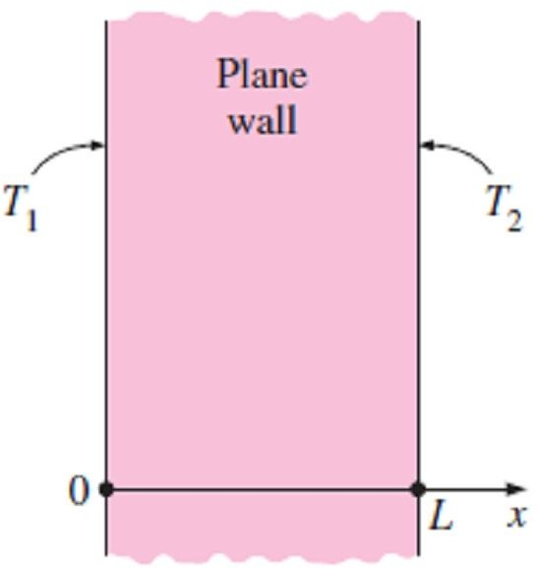
Chapter Two
Heat Conduction Equation
2.1-
Fig.(2.16).
Fig.(2.16) Schematic for Example-2.1
2.2-
Fig.(2.17).
Fig.(2.17) Schematic for Example-2.2

Slide 9
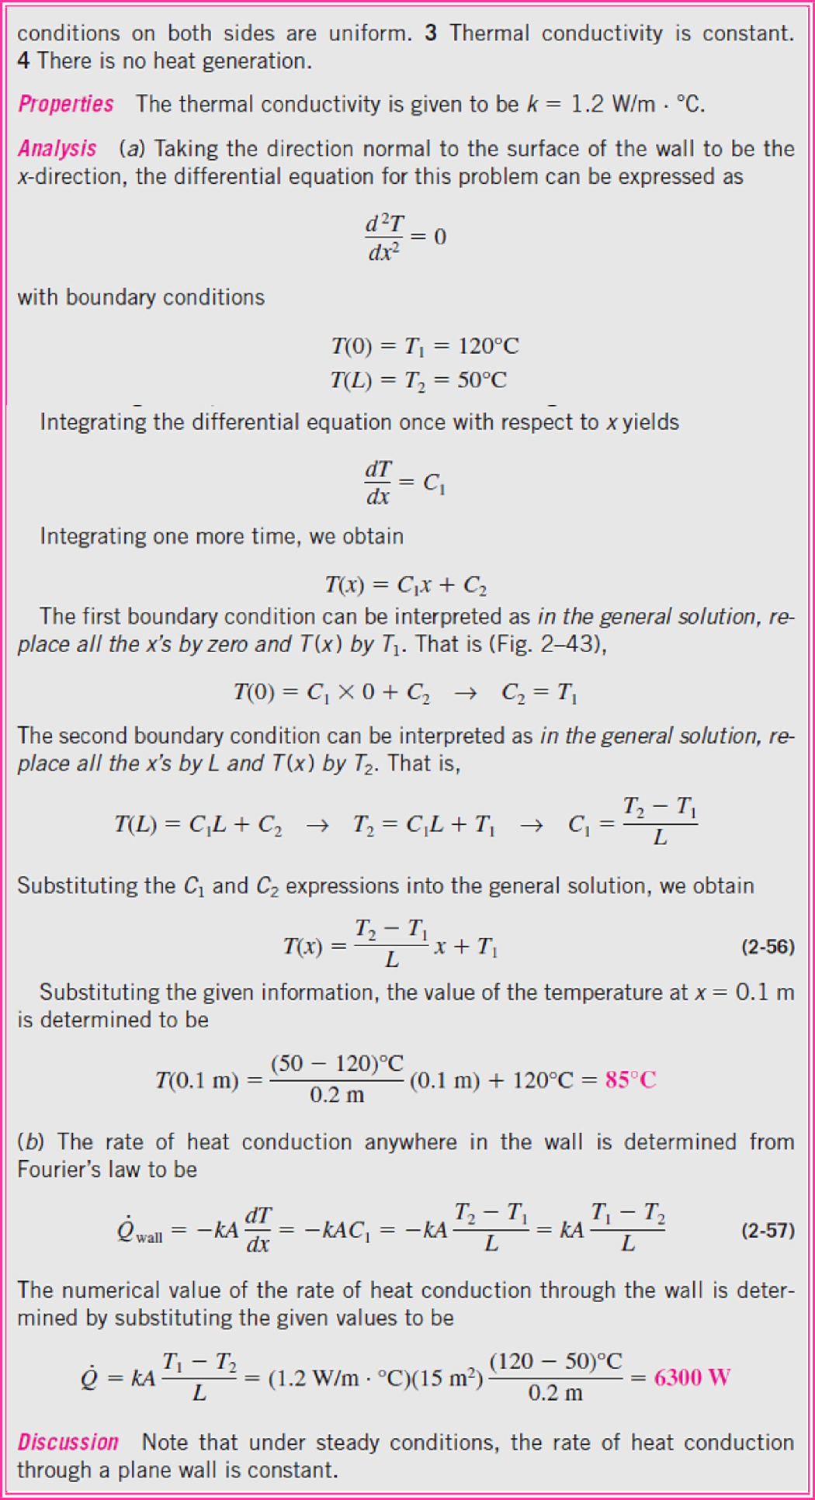
Chapter Two
Heat Conduction Equation

Slide 10
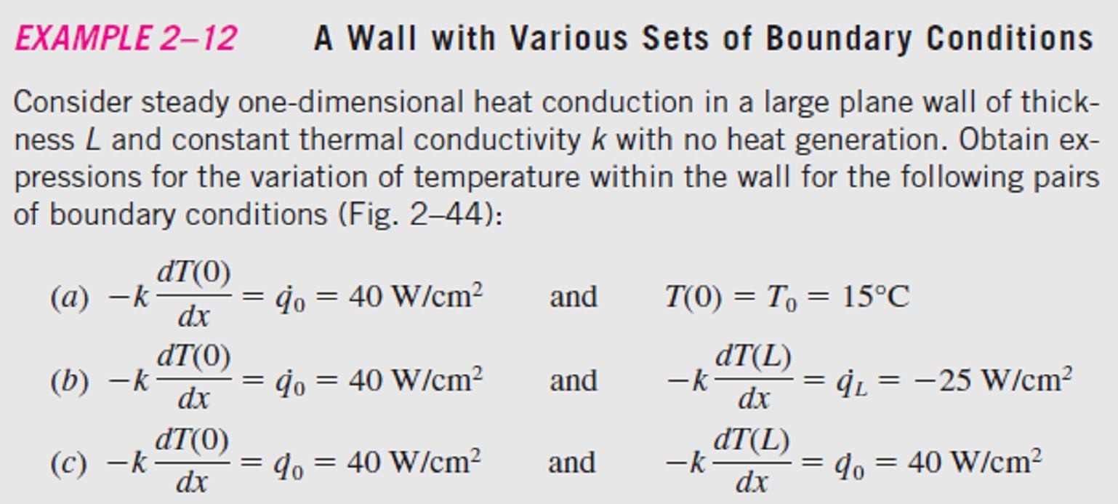
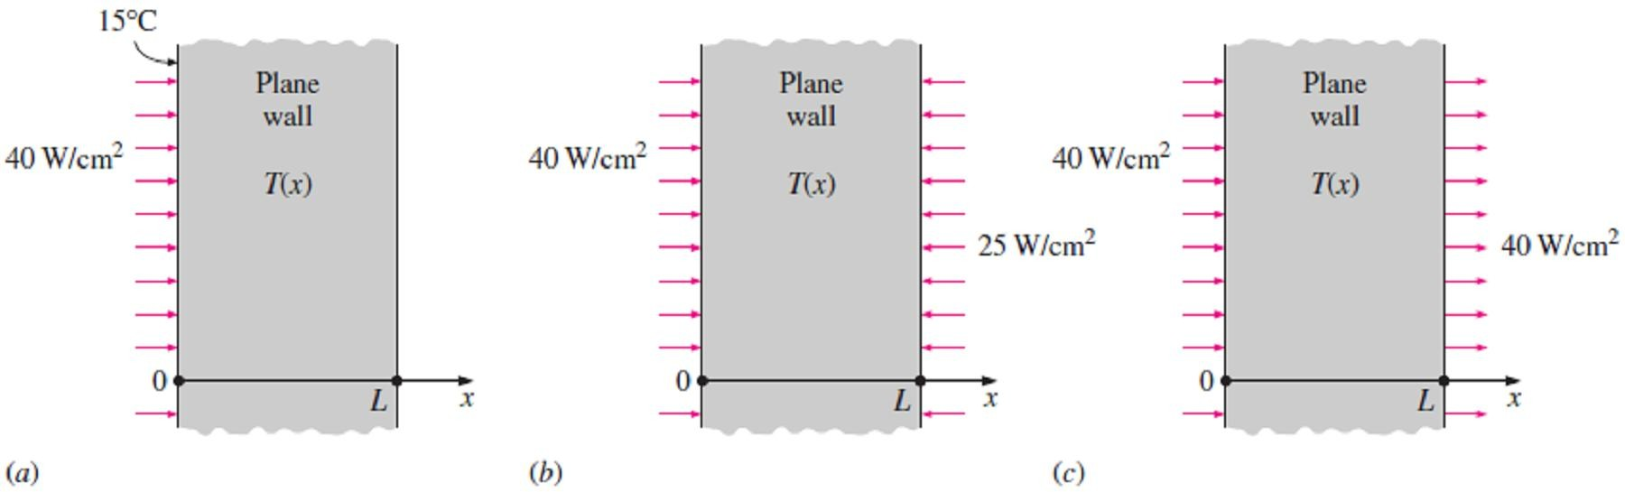
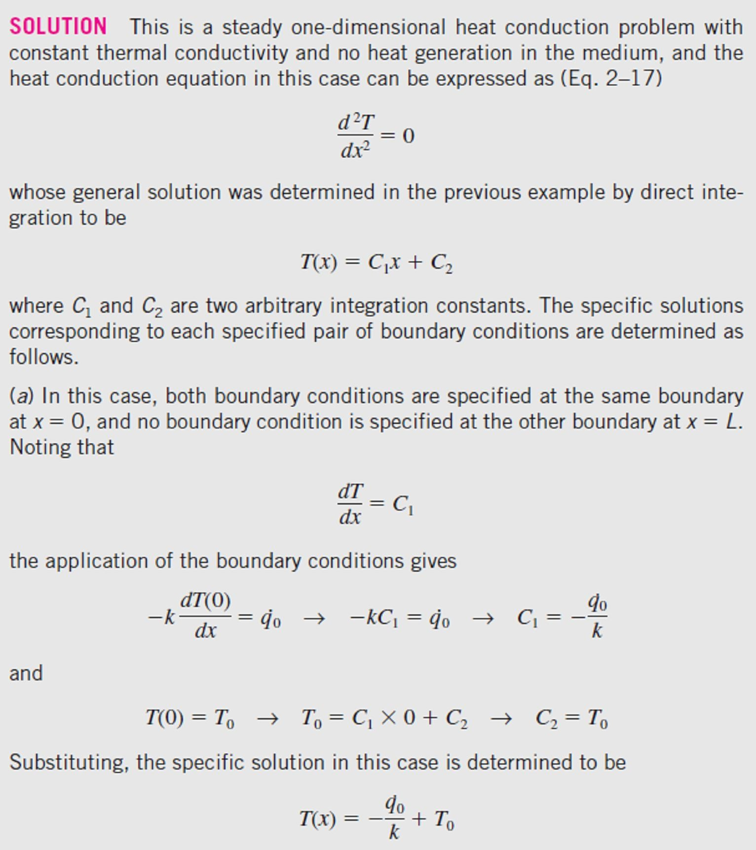
Chapter Two
Heat Conduction Equation
2.3-
as shown in Fig.(2.18).
Fig.(2.18) Schematic for Example-2.3

Slide 11
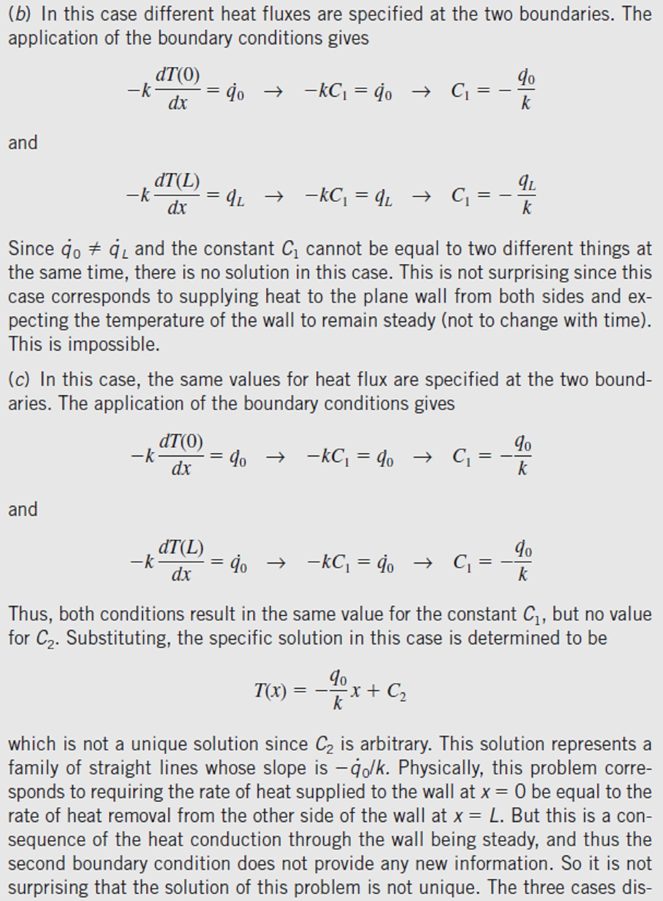
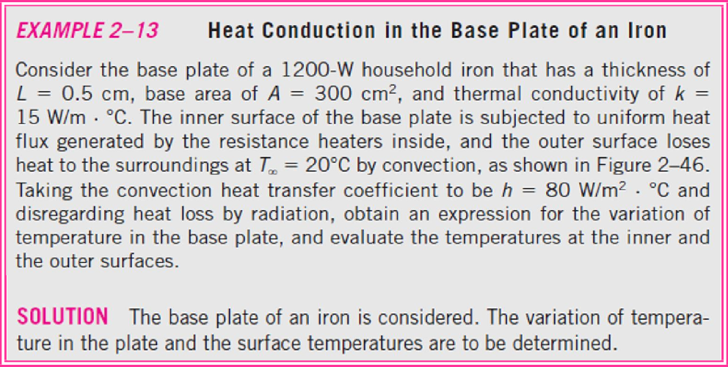
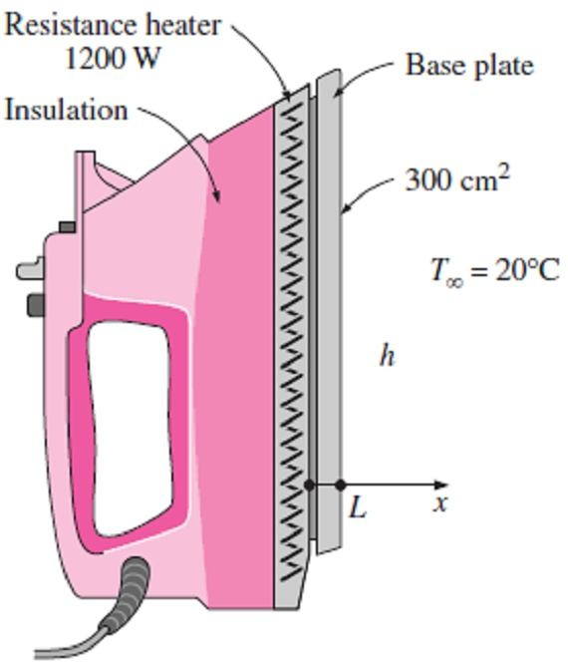
Chapter Two
Heat Conduction Equation
2.4-
Fig.(2.19).
Fig.(2.19) Schematic for Example-2.4

Slide 12
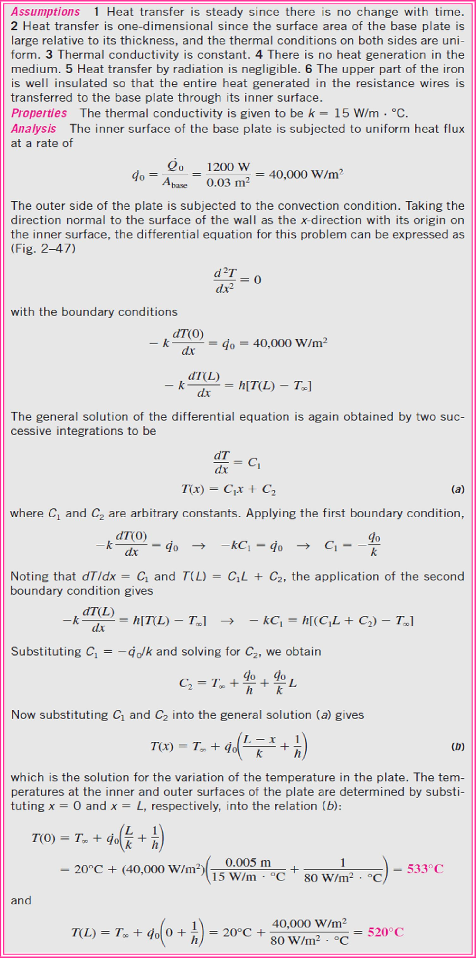
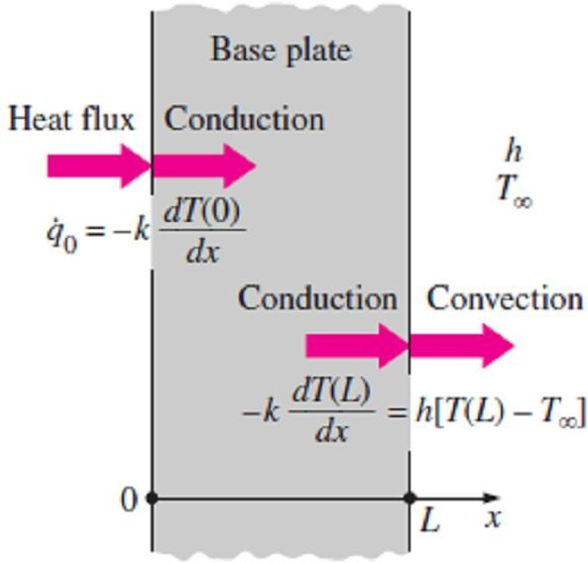
Chapter Two
Heat Conduction Equation
as shown in Fig.(2.20);
Fig.(2.20) The boundary conditions on the base plate of the iron discussed in Example-2.4

Slide 13
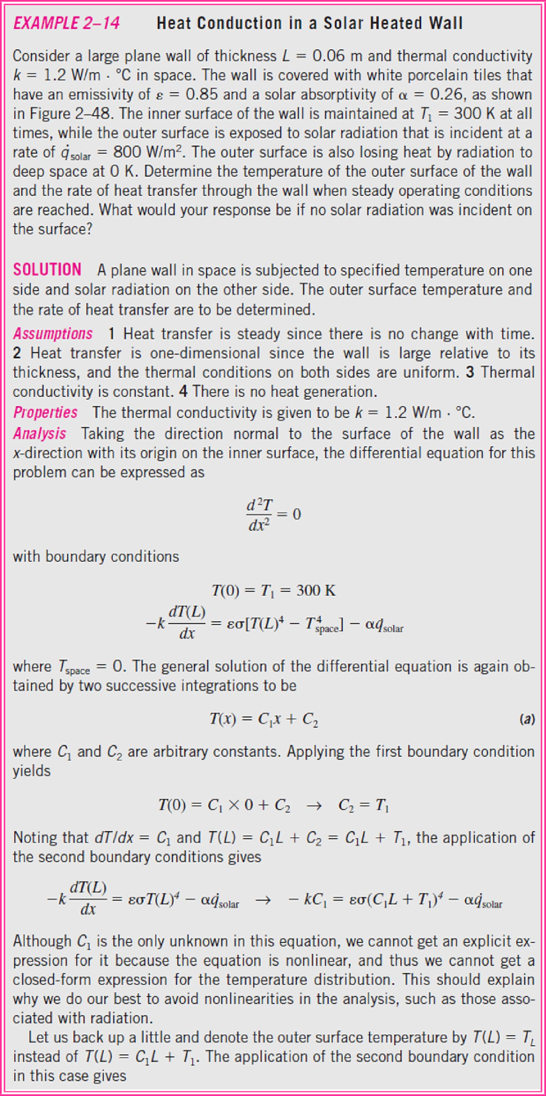
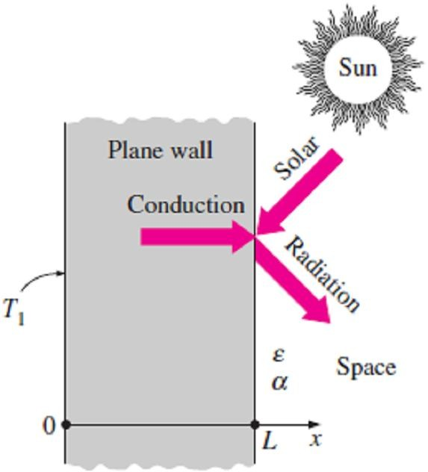
Chapter Two
Heat Conduction Equation
2.5-
Fig.(2.21).
Fig.(2.21) Schematic for Example-2.5

Slide 14
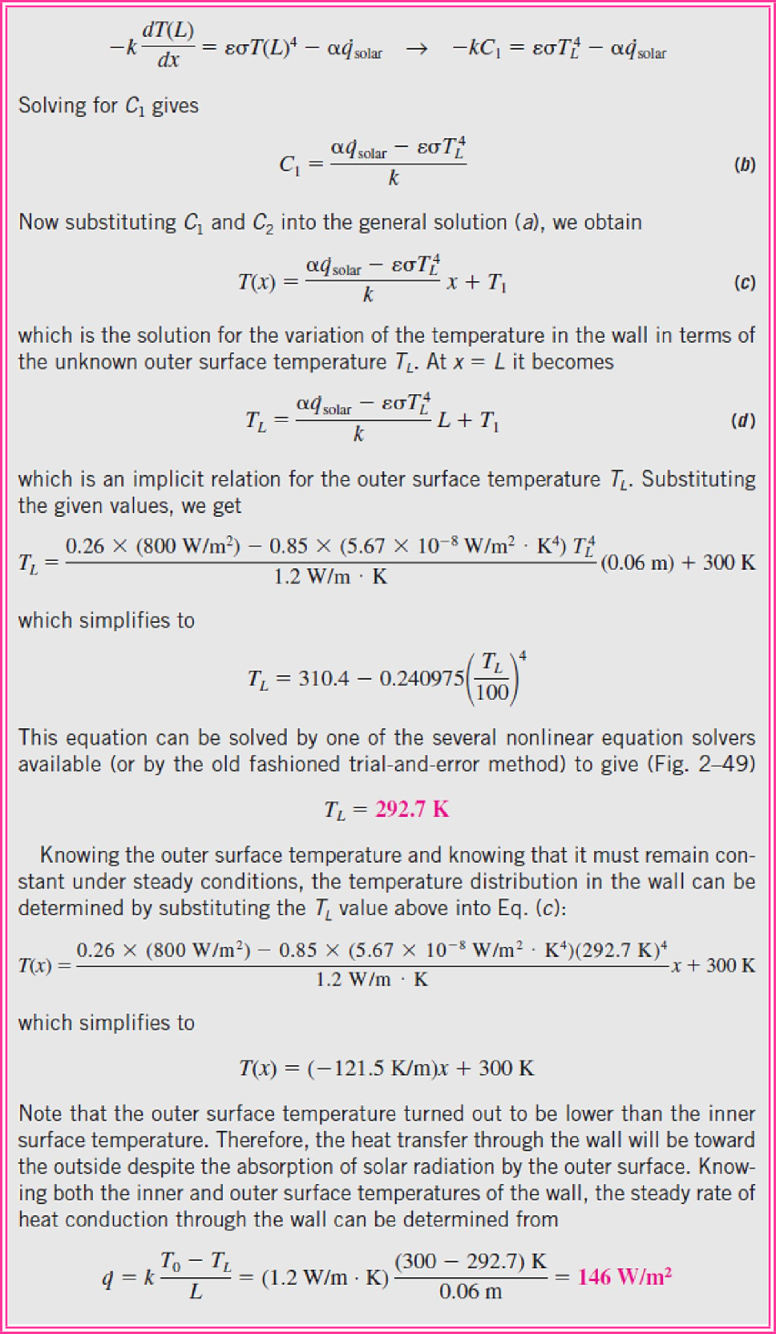
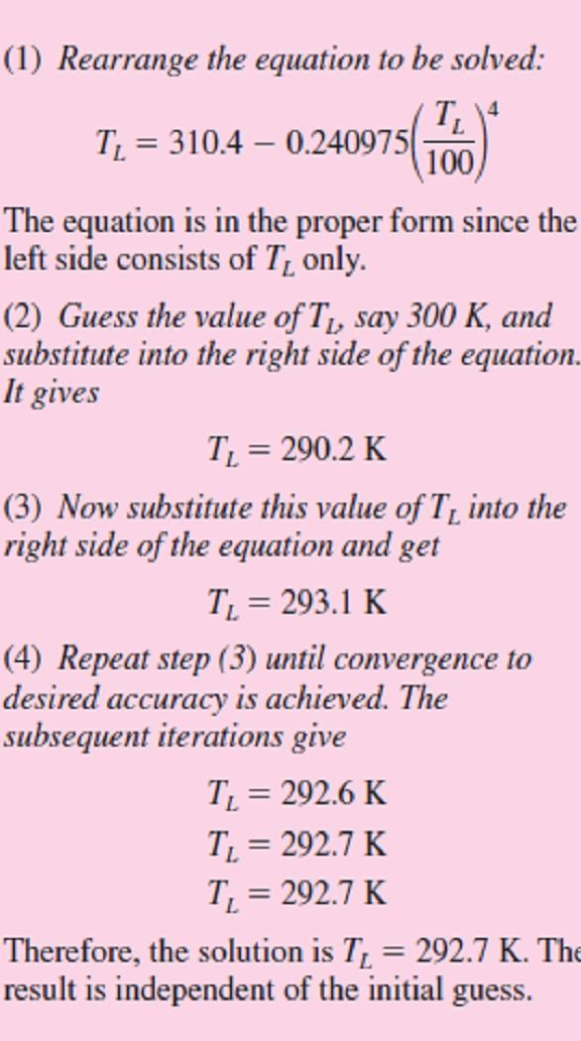
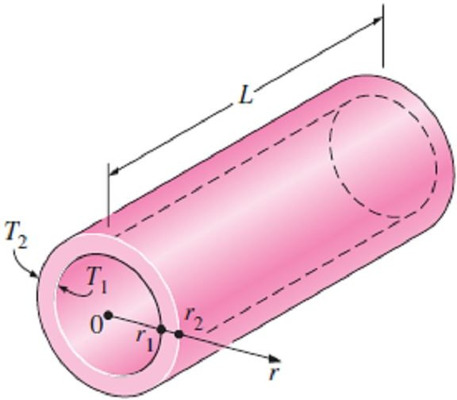
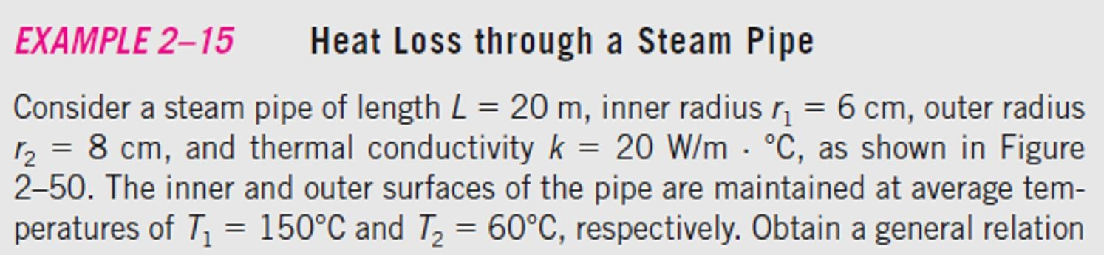
Chapter Two
Heat Conduction Equation
Fig.(2.22);
Fig.(2.22) A simple method of solving a nonlinear equation is to arrange the equation such that the unknown is alone on the left side while everything else is on the right side, and to iterate after an initial guess until convergence
(2.23).
2.6-
Fig.(2.23) Schematic for Example-2.6

Slide 15
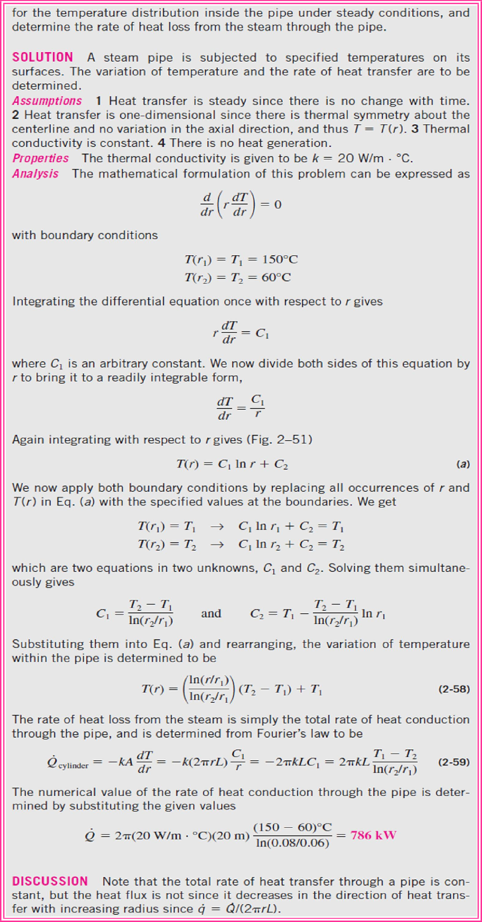
Chapter Two
Heat Conduction Equation

Slide 16
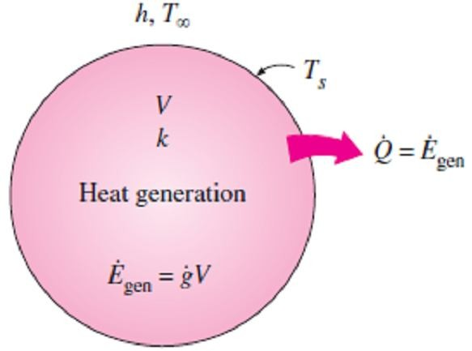
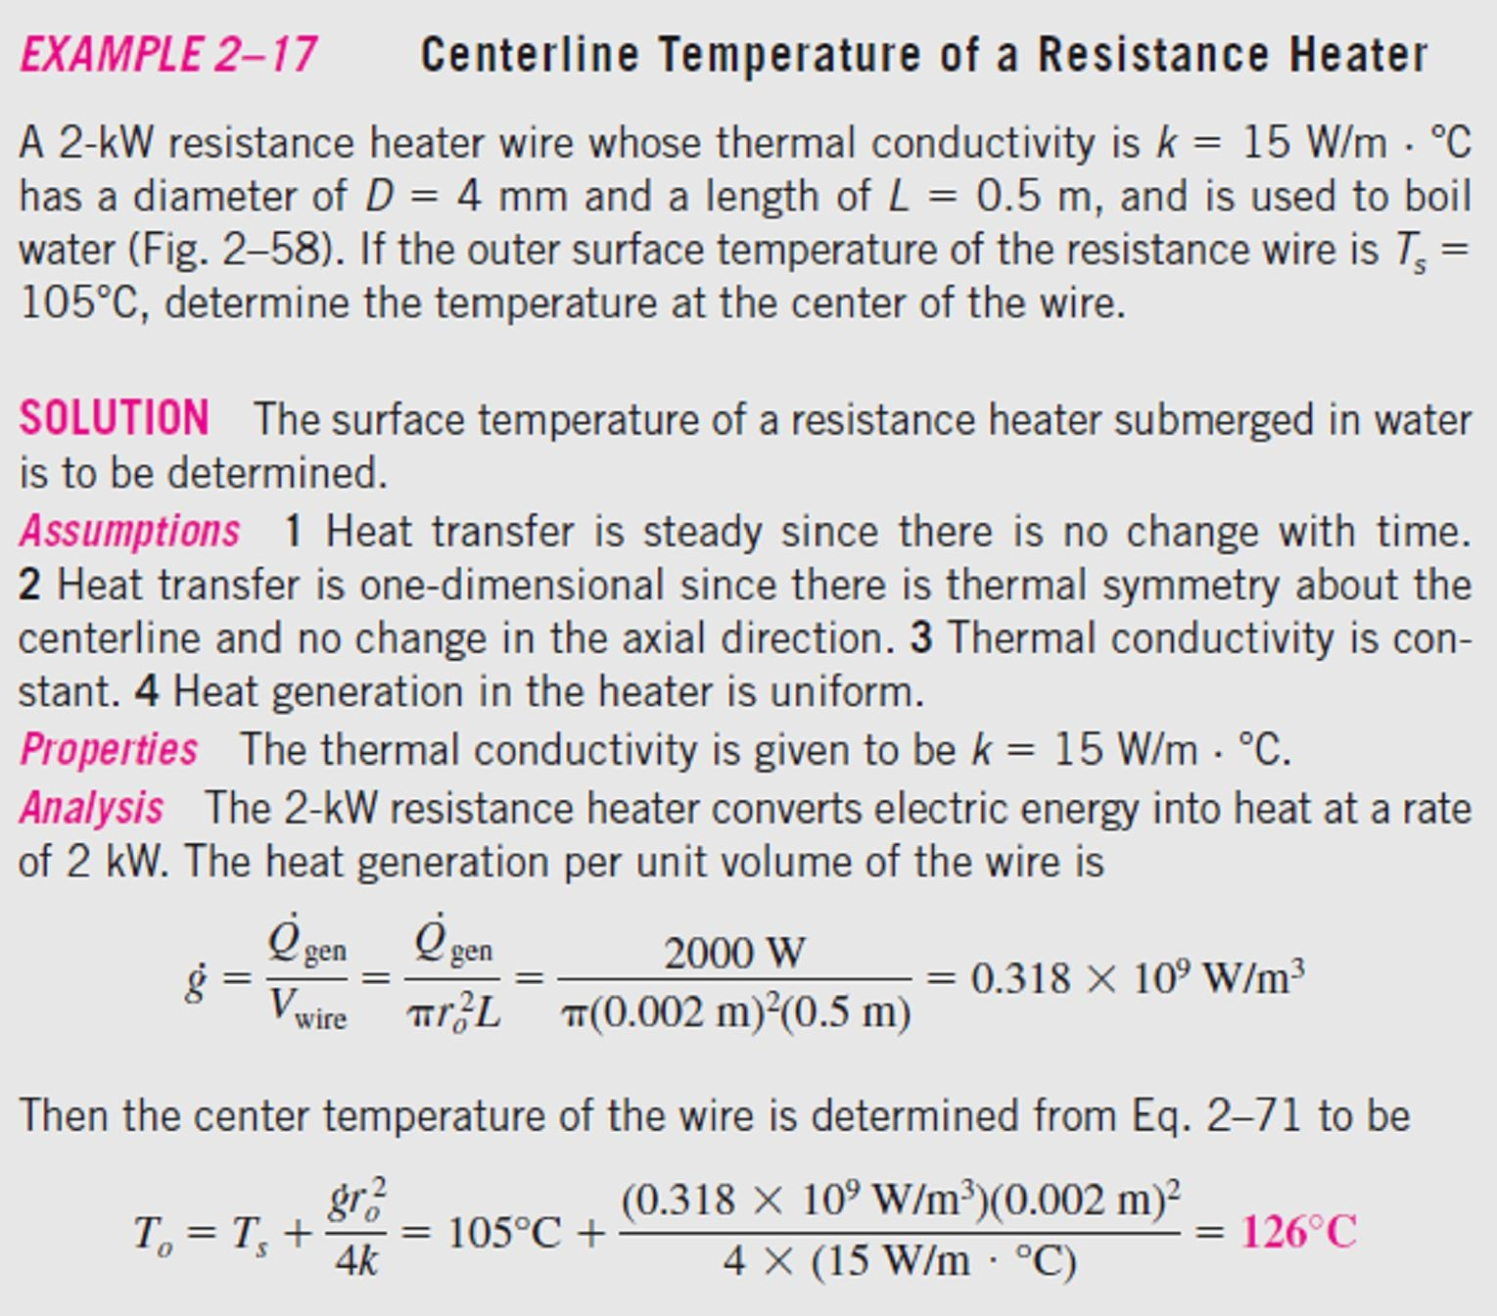
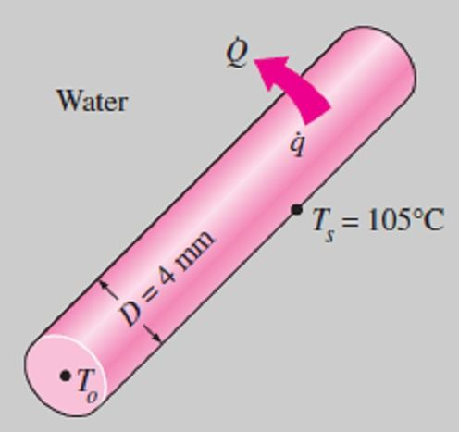
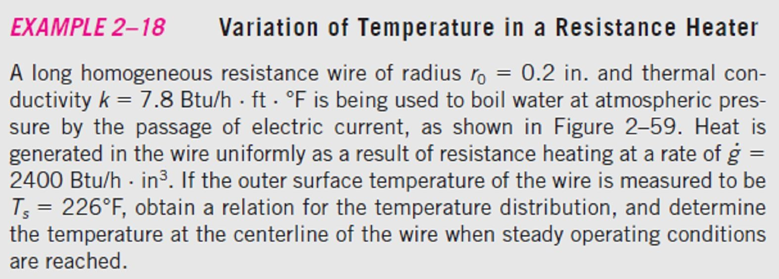
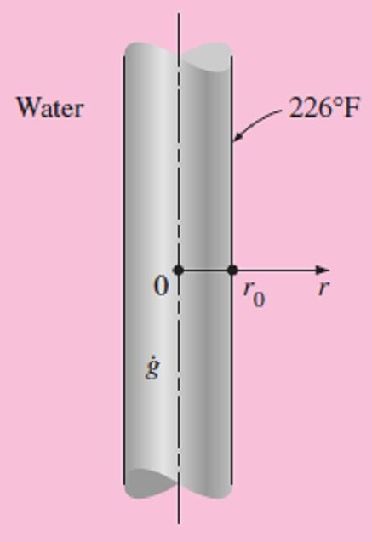
Chapter Two Heat Conduction Equation
2.5- Heat Generation in a Solid
Consider a solid medium of surface area A_{s}, volume V, and constant
thermal conductivity k, where heat is generated at a constant rate of g per unit volume. Heat is transferred from the solid to the surrounding medium at T∞, with a constant heat transfer coefficient of h. All the surfaces of the solid are maintained at a common temperature T_{s} as shown in Fig.(2.24). Under steady conditions, the energy balance for this solid can be expressed as;
⎛ Rate of ⎞ ⎛ Rate of
⎞
⎜
⎟ ⎜
⎟
⎜ heat transfer ⎟ = ⎜ energy generation⎟
☹(2.20)
⎜ fromthe solid ⎟
⎜
within the solid ⎟
Fig.(2.24) At steady conditions, the entire heat generated in a solid must leave the solid through its outer surface
⎝ ⎠ ⎝ ⎠
Note- from above equation we can compute the quantities of major interest in a medium with heat generation, such as; the surface temperature T_{s} and the maximum temperature T_{max} that occurs in the medium in steady operation.
2.7-
Fig.(2.25).
Fig.(2.25) Schematic for Example-2.7
as follow;
2.8-
Fig.(2.26).
Fig.(2.26) Schematic for Example-2.8

Slide 17
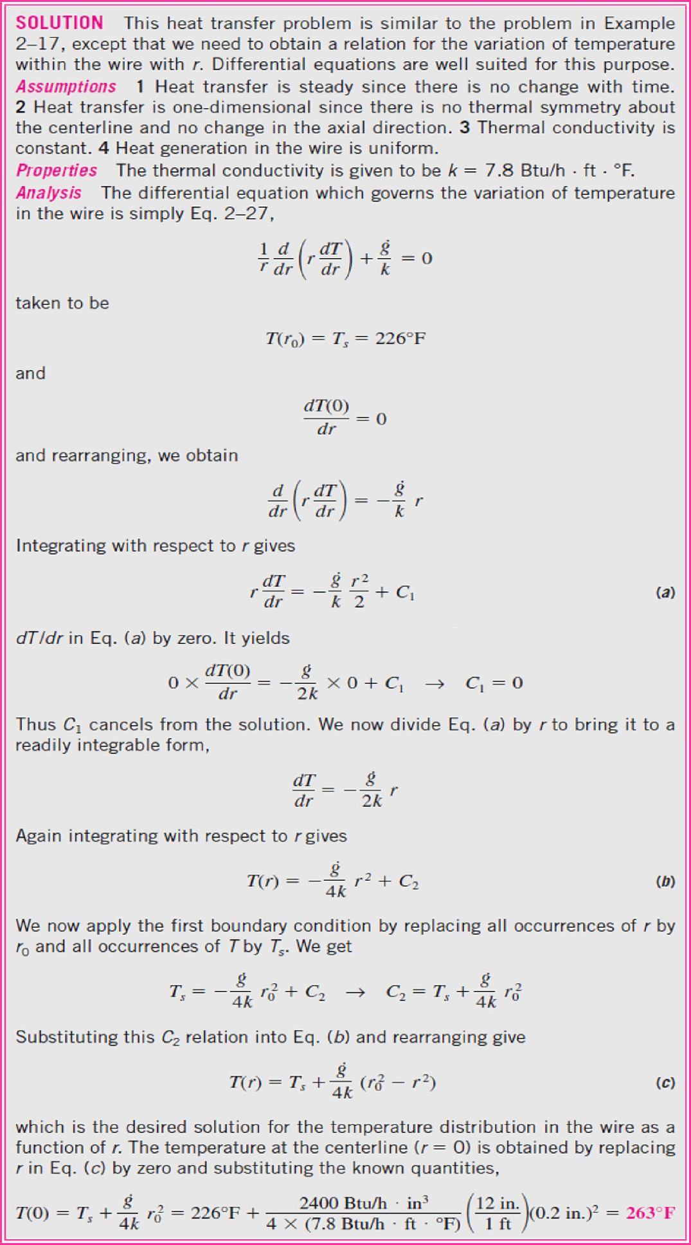
Chapter Two
Heat Conduction Equation
( 2.7 ),
;
The boundary conditions of the present problem will be as follow;
Multiplying both sides of the equation by r and rearranging, we obtain;

Slide 18
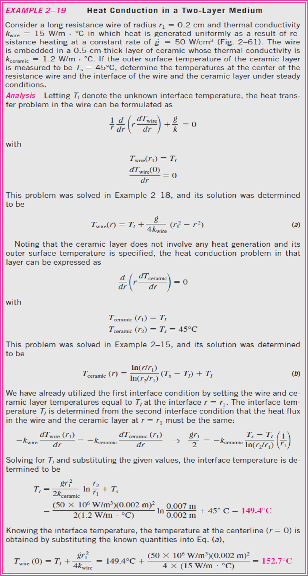
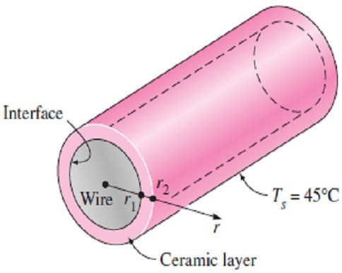
Chapter Two
Heat Conduction Equation
2.9-
as in Fig.(2.27).
Fig.(2.27) Schematic for Example-2.9
(2.8),
(2.6),

Slide 19
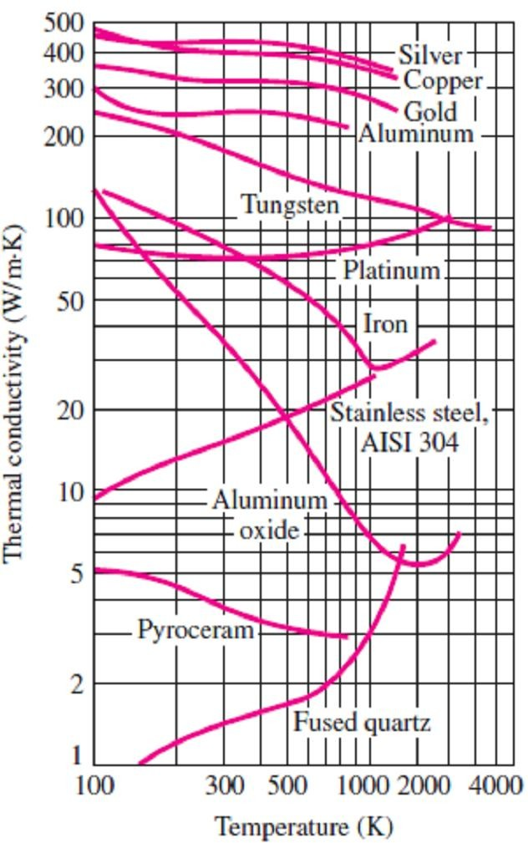
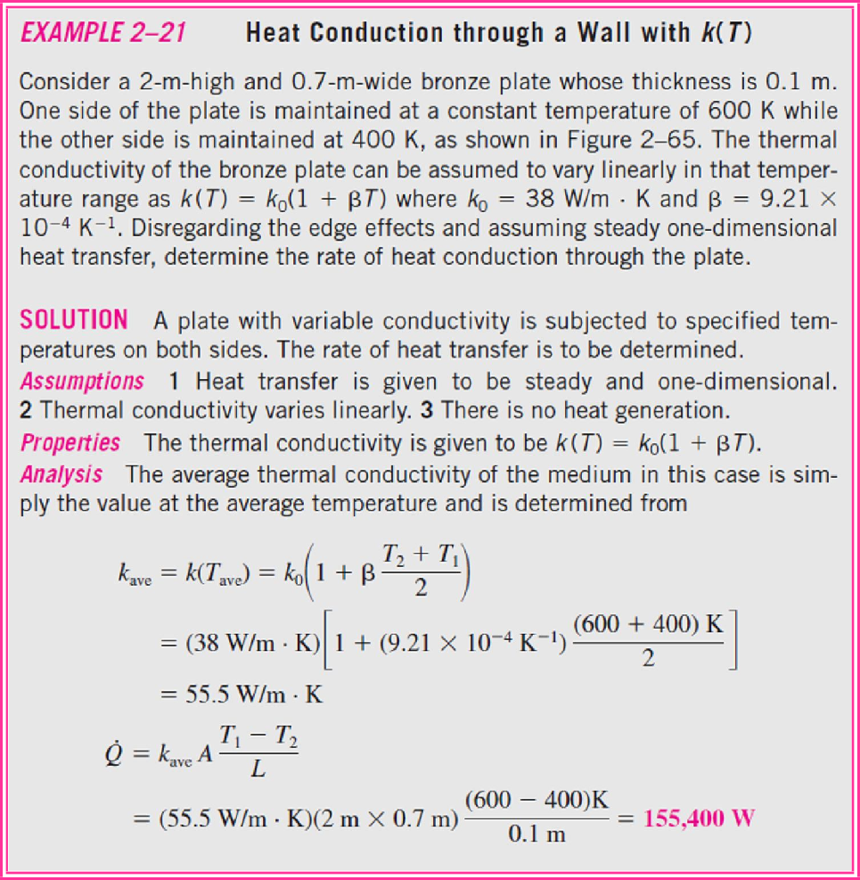
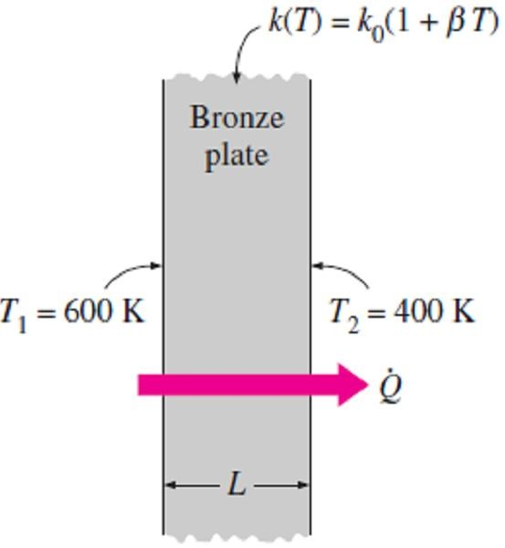
Chapter Two Heat Conduction Equation
2.6- Variable Thermal Conductivity, k (T)
As we say in chapter1 that the thermal conductivity of a material, in general, varies with temperature Fig.(2.28). In such cases, we can use an average value for the thermal conductivity and treat it as a constant, where if the variation of thermal conductivity with temperature k(T) is known, then the average value of the thermal conductivity in the
temperature range between T₁ and T₂ can be determined from;
T
∫
2
k (T ) dT
k =
T₁
☹ (2.21)
ave
T − T
2 1
Note- The variation in thermal temperature in the temperature approximated as;
k (T ) = k₀ (1 +  T )
conductivity of a material with
range of interest can often be
☹ (2.22 )
where β is called the temperature coefficient of thermal conductivity.
The average value of thermal conductivity in the temperature range T₁
to T₂ in this case can be determined from;
T
Fig.(2.28) Variation of the thermal conductivity of some solids with temperature
∫
2
k (1 +  T ) dT ₊
T₁
0
⎛
T T
⎞
k =
= k 1 + 
1
2
= k (T )
ave
T − T
₀ ⎜
2
⎟
ave
2 1
⎝ ⎠
☹ (2.23)
Note that the average thermal conductivity in this case is equal to the thermal conductivity value at the average temperature.
2.10-
as shown in Fig.(2.29).
Fig.(2.29) Schematic for Example-2.10

Slide 20
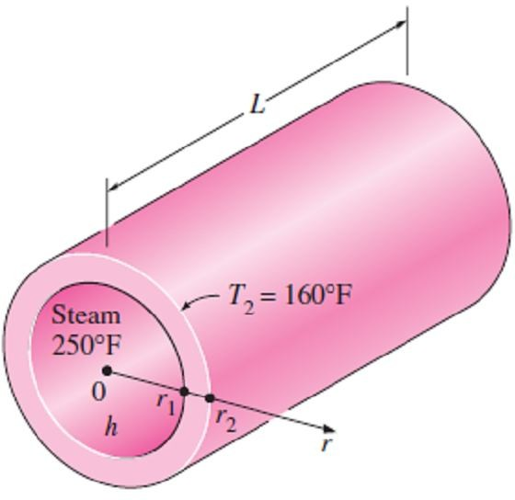
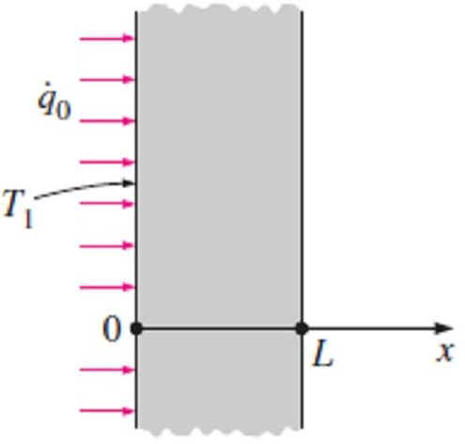
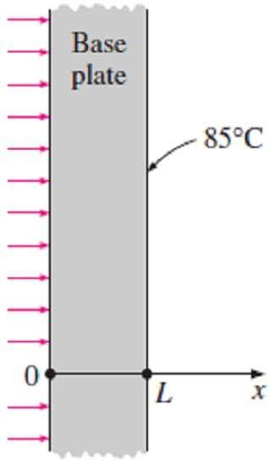
Chapter Two
Heat Conduction Equation
2.1- Consider a large plane wall of thickness L=0.4m, thermal conductivity k = 2.3 W/m ·C°, and surface area A =20m². The left side of the wall is maintained at a constant temperature of T₁=80C° while the right side loses heat by convection to the surrounding air at T∞=15C° with a heat transfer coefficient of h=24 W/m²·C°. Assuming constant thermal conductivity and no heat generation in the wall, (a) express the differential equation and the boundary conditions for steady one-dimensional heat conduction through the wall, (b) obtain a relation for the variation of temperature in the wall by solving the differential equation, and (c) evaluate the rate of heat transfer through the wall.
Answer: (c) 6030 W 2.2- Consider a solid cylindrical rod of length 0.15m and diameter 0.05m. The top and bottom surfaces of the rod are maintained at constant temperatures of 20C° and 95C°, respectively, while the side surface is perfectly insulated. Determine the rate of heat transfer through the rod if it is made of (a) copper, k = 380 W/m ·C°,
(b) steel, k = 18 W/m ·C°, and (c) granite, k = 1.2 W/m ·C°.
Answers: 373.1 W, 17.7 W, 1.2 W
2.3- Consider the base plate of a 800W household iron with a thickness of L = 0.6cm, base area of A=160cm², and thermal conductivity of k =20 W/m ·C°. The inner surface of the base plate is subjected to uniform heat flux generated by the resistance heaters inside. When steady operating
2.4- Consider a steam pipe of length L= 15ft, inner radius r₁ = 2in, outer radius r₂ = 2.4in, and thermal conductivity k = 7.2 Btu/h · ft ·F°. Steam is flowing through the pipe at an average
temperature of 250F°, and the average
convection heat transfer coefficient on the inner
surface is given to be h=1.25 Btu/h· ft² ·F°. If the average temperature on the outer surfaces of the pipe is T₂=160F°, (a) express the differential equation and the boundary conditions for steady one-dimensional heat conduction through the pipe, (b) obtain a relation for the variation of temperature in the pipe by solving the differential equation, and (c) evaluate the rate of heat loss from the steam through the pipe.
Answer: (c) 16,800 Btu/h
2.5- Consider a large plane wall of thickness L=0.3m, thermal conductivity k=2.5W/m·C°, and surface area A=12 m². The left side of the wall at
x=0 is subjected to a net heat flux of q₀ =700 W/m² while the temperature at that surface is measured to be T₁=80C°. Assuming constant
thermal conductivity and no heat generation in the wall, (a) express the differential equation and
conditions are reached, the outer surface
temperature of the plate is measured to be 85C°. Disregarding any heat loss through the upper part
of the iron, (a) express the differential equation and the boundary conditions for steady one- dimensional heat conduction through the plate,
(b) obtain a relation for the variation of
temperature in the base plate by solving the differential equation, and (c) evaluate the inner
the boundary conditions for steady one-
dimensional heat conduction through the wall, (b)
obtain a relation for the variation of temperature in the wall by solving the differential equation, and (c) evaluate the temperature of the right
surface of the wall at x=L. Answer: (c) -4C°
surface temperature. Answer: (c) 100C°
2.6- Repeat Prob.(2.5) for a heat flux of 950 W/m² and a surface temperature of 85C° at the left surface at x=0. Answer: (c) -29C°

Slide 21



Chapter Two
Heat Conduction Equation
2.7- A large steel plate having a thickness of L=4in, thermal conductivity of k=7.2 Btu/h·ft·F°, and an emissivity of ε=0.6 is lying on the ground. The exposed surface of the plate at x=L is known to exchange heat by convection with the ambient air at T∞=90F° with an average heat transfer coefficient of h =12 Btu/h ·ft² ·F° as well as by radiation with the open sky with an equivalent sky temperature of T_{sky}=510R°. Also, the temperature of the upper surface of the plate is measured to be 75F°. Assuming steady one- dimensional heat transfer, (a) obtain a relation for the variation of temperature in the plate by solving the conduction differential equation, and
(b) determine the value of the lower surface temperature of the plate at x=0.
Answer: (b) 67.3 F°
2.10- A 2kW resistance heater wire with thermal conductivity of k =20 W/m ·C°, a diameter of D=5mm, and a length of L=0.7m is used to boil water. If the outer surface temperature of the resistance wire is T_{s}=110C°, determine the temperature at the center of the wire.
Answer: 121.4 C° 2.11- A long homogeneous resistance wire of radius r₀=0.25in and thermal conductivity k =8.6 Btu/h ·ft ·F° is being used to boil water at atmospheric pressure by the passage of electric current. Heat is generated in the wire uniformly as a result of resistance heating at a rate of
g =1800 Btu/h ·in³. The heat generated is transferred to water at 212F° by convection with an average heat transfer coefficient of h=820 Btu/h ·ft² ·F°. Assuming steady one-dimensional heat transfer, (a) obtain a relation for the
variation of temperature in the wire by solving the differential equation, and (b) determine the temperature at the centerline of the wire.
Answer: (b) 290.8F°
2.8- Repeat Prob.(2.7) by disregarding radiation heat transfer. Answer: (b) 66.7 F°
2.9- Consider a compressed air pipe of length L=6m, inner radius r₁=3.7cm, outer radius r₂=4cm, and thermal conductivity k =14 W/m ·C° equipped with a 300W strip heater. Air is flowing through the pipe at an average temperature of
-10C°, and the average convection heat transfer coefficient on the inner surface is h=30 W/m²·C°. Assuming 15% of the heat generated in the strip heater is lost through the insulation, (a) obtain a relation for the variation of temperature in the pipe material by solving the steady one-
2.12- Consider a large 3cm-thick stainless steel plate (k=15.1 W/m·C°) in which heat is generated uniformly at a rate of 5×10⁵ W/m³. Both sides of the plate are exposed to an environment at 30C° with a heat transfer coefficient of 60 W/m²·C°. Explain where in the plate the highest and the lowest temperatures will occur, and determine
their values. Answers: 155 C°, 158.7 C° 2.13- Consider a large 5cm-thick brass plate
(k=111W/m·C°) in which heat is generated
uniformly at a rate of 2×10⁵ W/m³. One side of the plate is insulated while the other side is exposed to an environment at 25C° with a heat transfer coefficient of 44W/m²·C°. Explain where
dimensional heat conduction differential
equation, and (b) evaluate the inner and outer surface temperatures of the pipe.
Answers: (b) -3.91C°, -3.87C°
in the plate the highest and the lowest
temperatures will occur, and determine their
values. Answers: 252.3 C°, 254.5 C°
2.14- A 6m-long, 2kW electrical resistance wire is made of 0.2cm-diameter stainless steel (k =
15.1 W/m ·C°). The resistance wire operates in an environment at 30C° with a heat transfer
coefficient of 140W/m² ·C° at the outer surface. Determine the surface temperature of the wire.
Answer: 409 C°
37

Slide 22


Chapter Two
Heat Conduction Equation
2.15- Consider a cylindrical shell of length L, inner radius r₁ and outer radius r₂ whose thermal conductivity varies linearly in a specified temperature range as k(T)=k₀(1+ β T) where k₀ and β are two specified constants. The inner surface of the shell is maintained at a constant temperature of T₁ while the outer surface is
surface are not known. However, the outer surface of the wall at x=L, whose emissivity is ε
=0.7, is known to exchange heat by convection
with ambient air at T∞=25C° with an average heat transfer coefficient of h=14 W/m² ·C° as well as by radiation with the surrounding surfaces at an average temperature of T_{surr}=290K°. Further, the temperature of the outer surface is measured to be T₂= 45C°. Assuming steady one-dimensional heat transfer, (a) obtain a relation for the temperature of the outer surface of the plate by solving the conduction differential equation, and
(b) evaluate the inner surface temperature of the wall at x=0. Answer: (b) 64.3C°
maintained at T₂. Assuming steady one-
dimensional heat transfer, obtain a relation for (a)
the heat transfer rate through the shell and (b) the temperature distribution T(r) through the shell.
2.16- Consider a cylindrical shell of length L, inner radius r₁, and outer radius r₂ whose thermal conductivity varies in a specified temperature range as k(T)=k₀(1+ β T ²) where k₀ and β are two specified constants. The inner surface of the shell is maintained at a constant temperature of T₁ while the outer surface is maintained at T₂. Assuming steady one-dimensional heat transfer, obtain a relation for the heat transfer rate through the shell.
2.17- Consider a 1.5m-high and 0.6m-wide plate whose thickness is 0.15m. One side of the plate is maintained at a constant temperature of 500K while the other side is maintained at 350K. The thermal conductivity of the plate can be assumed to vary linearly in that temperature range as k(T)
=k₀(1+β T) where k₀ =25W/m·K and β = 8.7×10⁻⁴
2.20- A 1000W iron is left on the iron board with its base exposed to ambient air at 20C°. The base plate of the iron has a thickness of L=0.5cm, base area of A=150cm², and thermal conductivity of k=18 W/m ·C°. The inner surface of the base plate is subjected to uniform heat flux generated by the resistance heaters inside. The outer surface of the base plate whose emissivity is ε=0.7, loses heat by convection to ambient air at T∞ = 22C° with an average heat transfer coefficient of h = 30W/m²·C° as well as by radiation to the surrounding surfaces at an average temperature of T_{surr} =290K°. Disregarding any heat loss through the upper part of the iron. Assuming steady one- dimensional heat transfer, (a) obtain a relation for the temperature of the outer surface of the plate by solving the conduction differential equation, and (b) evaluate the outer surface temperature.
Answer: (b) 758 C°
_{K}-1.
Assuming steady one-dimensional heat
transfer, determine the rate of heat conduction
through the plate. Answer: 30,800 W
2.18- Consider a steam pipe of length L, inner radius r₁, outer radius r₂, and constant thermal conductivity k. Steam flows inside the pipe at an average temperature of T_{i} with a convection heat transfer coefficient of h_{i}. The outer surface of the pipe is exposed to convection to the surrounding air at a temperature of T_{o} with a heat transfer
coefficient of h_{o}. Assuming steady one-
dimensional heat conduction through the pipe, (a) obtain a relation for the variation of temperature in the pipe material by solving the conduction differential equation, and (b) obtain a relation for the temperature of the outer surface of the pipe.
2.19- Consider a large plane wall of thickness L=0.4m and thermal conductivity k =8.4W/m·C°. There is no access to the inner side of the wall at x =0 and thus the thermal conditions on that

Slide 23

Chapter Two
Heat Conduction Equation
2.21- Consider a long resistance wire of radius
r₁=0.3cm and thermal conductivity k_{wire} =18 W/m
C° in which heat is generated uniformly at a
constant rate of g = 1.5 W/cm³ as a result of
resistance heating. The wire is embedded in a 0.4cm-thick layer of plastic whose thermal conductivity is k_{plastic}=1.8W/m·C°. The outer surface of the plastic cover loses heat by convection to the ambient air at T∞=25C° with an average combined heat transfer coefficient of h = 14W/m²·C°. Assuming one-dimensional heat transfer, determine the temperatures at the center of the resistance wire and the wire-plastic layer interface under steady conditions.
Answers: 97.1C°, 97.3C°
2.22- Consider a 20cm-thick large concrete plane wall (k = 0.77 W/m ·C°) subjected to convection on both sides with T₁ = 27C° and h₁ = 5 W/m²
C° on the inside, and T₂ = 8C° and h₂ = 12 W/m²
C° on the outside. Assuming constant thermal conductivity with no heat generation and negligible radiation. (a) express the differential equations and the boundary conditions for steady one-dimensional heat conduction through the wall, (b) obtain a relation for the variation of temperature in the wall by solving the differential equation, and (c) evaluate the temperatures at the inner and outer surfaces of the wall.
Answers: 20C°, 10.9C°
2.23- Consider a water pipe of length L = 12m, inner radius r₁ =15cm, outer radius r₂ =20cm, and thermal conductivity k = 20 W/m ·C°. Heat is generated in the pipe material uniformly by a 25kW electric resistance heater. The inner and outer surfaces of the pipe are at T₁ = 60C° and T₂
= 80C°, respectively. Obtain a general relation for temperature distribution inside the pipe under steady conditions and determine the temperature at the center plane of the pipe.
Answer: 71.2C°

